Slide 1
Banzarov Buryat State University

Slide 2
BSU
University is the leader of fundamental science in the region. Active student participation in research work creates the basis for the successful application of acquired knowledge in practice, it develops research skills, and the ability to work in a team. This is confirmed by victories and prizes at international and all-Russian conferences, competitions and academic olympiads.

Slide 3
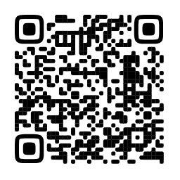
Areas of training
BSU is one of the leading educational and scientific centers of Siberia and the Far East.

Slide 4
Institute of Mathematics, Physics and Computer Science
Physics
Applied Mathematics and Computer Science
Applied Computer Science
Mathematical Support and Administration of Information Systems
Information Systems and Technologies
Power Engineering Industry
Pedagogical Education (with two vocational training) –
Mathematics and Physics

Slide 5
Institute of Natural Sciences
Biology
Geography
Chemistry
Geology
Ecology and Nature Management
Pedagogical Education (with two vocational training) - Biology and Chemistry

Slide 6
Institute of Oriental studies
Oriental and African Studies
Foreign Regional Studies
Philosophy

Slide 7
Institute of History and Philology
Philology
Linguistics
Journalism
History
Political Science
Social Science
Theology

Slide 8
Institute of History and Philology
Pedagogical education (with two vocational trainings):
History and Social Science
Native Language and Literature and Russian language and literature
English and German Languages
Russian Language and Literature

Slide 9
Institute of Pedagogy and Psychology
Pedagogical Education
Pedagogical Education (with two vocational trainings)
Primary and Preschool Education
Technology and Informatics
Psychology
Psychological and Pedagogical Education
Social Work

Slide 10
Institute of Law and Economics
Economy
Management
State and Municipal Administration
Law

Slide 11
Institute of Physical Culture, Sports and Tourism
Physical Education
Pedagogical education
Physical Education
Pedagogical education (with two vocational trainings):
Physical Education and Life Safety
Tourism

Slide 12
Medical Institute
Medicine
Pharmacy

Slide 13
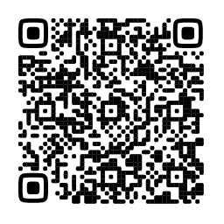
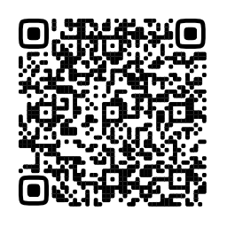
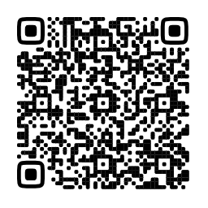
BSU College
bachelor's degree
Master's degree

Slide 14
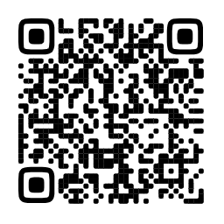
Student life

Slide 15
Social activities
Federation of Student Government
Primary Trade Union Organization of Students
Student Sports Club "Baikal Wolves"
Regional Public Organization "Mercy"
Student Scientific Society
Volunteer Doctors
Patriotic Club "I Am Proud"
Creative Laboratory "Event Sounds"
BSU strong students’ communities influence the university life

Slide 16
Cultural and creative activities
Folk student song and Dance ensemble "Baikal waves”
Studio of sports and ballroom dancing "Effect"
Ethno-studio "Ayadon"
Student song and dance ensemble "Baikal gems"
Modern dance studio "Project A2"
Creative teams invite you to join and bring your talent to light in modern or folk dancing and singing. Out gifted students participate at different festivals, competitions and activities.

Slide 17
sports activities
BSU Track and Field Team
BSU Archery Team
BSU Freestyle Wrestling Team
BSU Women's Volleyball Team
BSU Men's Volleyball Team
BSU Men's Basketball Team
BSU Women's Basketball Team
BSU Football Team
BSU Hockey Team
BSU gives you an opportunity for physical improvement. The university traditions are based on the strong foundation of Buryat athletes’ achievements at major competitions in Europe and the world. BSU athletes regularly take part in city interuniversity, regional, regional, all-Russian and international competitions, and are among their prize-winners.

Slide 18
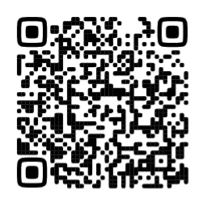
Scholarship and financial aid
Type of scholarship | Scholarship amount (rubles) per month
State Academic Scholarship | 4 780
State bursary | 3 900
Increased bursary for 1st and 2nd year students | 5 240
For achievements in educational activities | 21 120
For achievements in scientific research activities | 21 120
For achievements in public activities | 15 100
For achievements in cultural and creative activities | 15 100
For achievements in sports activities | 15 100

Slide 19
BSU Dormitories
The payment will be 760 rubles per month for corridor-type dormitories located at the following addresses:
Sukhe-Batora St., 10 (No. 2),
Borsoeva St., 11 (No. 3),
Gagarina St., 45 (No. 6).
For sectional-type dormitories, the payment will be 847 rubles. The dormitories are located at the following address:
Sukhe-Batora St., 3a (No. 4),
Sukhe-Batora St., 3b (No. 5)
The construction of a new 11-story dormitory in the city center at 25 Pushkin St. will also be completed soon.

Slide 20
The university gives access to wide academic data. The scientific library fund contains more than 1.2 million copies of books. Its structure includes an electronic reading room with full-text access to the Russian State Dissertation Library (RSL).

Slide 21
BSU is a friendly family of students and professors
about 10,000 students
393 postgraduate students and 16 doctoral students;
more than 1,000 teachers:
30 academicians and members of public academies of Russia;
6 corresponding members of Russian academies: RAS, RAO, RAMS;
90 doctors of science;
over 300 candidates of science.
More than 350 foreign students

Slide 22
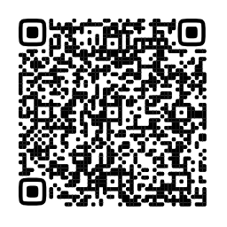
BSU has extensive international connections. Our students have the opportunity to undergo educational and scientific internships, educational and industrial practices at foreign universities.

Slide 23
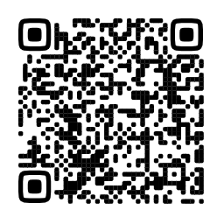
List of required documents
Copy of your foreign passport
Notarized copy of the certificate/diploma, copy of all pages + translation of certificate
2 photos of 3*4
State tax for issuing invitation to enter Russia (960 rubles)
International Relations Department email: intdep@bsu.ru

Slide 24
contacts
8 3012 21-18-64
8 3012 21-74-26
www.bsu.ru – official website
International Relations Department email: intdep@bsu.ru
Ulan-Ude, Suhke-Bator Str., 16

